Slide 1


MD Simulations with OpenMM
Camilla Caprai National Research Council of Italy camillacaprai@cnr.it toni.giorgino@cnr.it
@giorginolab
www.giorginolab.it
University of Padova c/o Prof. Fuxreiter
April 1st, 2025
https://github.com/giorginolab/MD-Tutorial-Data
Notes:
1

Slide 2
This class
Molecular dynamics is a powerful computational method for investigating molecular systems.
OpenMM is a software library enabling efficient and highly customizable MD simulations.
Exemplary characteristics of a modern open-source library:
Robust continuous integration (CI) infrastructure;
Developed collaboratively on GitHub;
Core implementation in C++ with comprehensive Python bindings.
Practical approach: we’ll test the Python live on Google Colab.

Slide 3
Molecular Dynamics

Slide 4
What is MD?
A computational method that:
Develops a comprehensive description of molecular systems through:
Atomistic representation;
Classical mechanical approach.
Models internal interatomic forces to:
Integrate equations of motion over time;
Predict atomic trajectories with precision.
Aims for convergent sampling.

Slide 5
MD is entirely about timescales
Quantitative results are fundamentally constrained by sampling capabilities. You can only investigate phenomena occurring within or shorter than the sampled timescales.
Accessible Phenomena:
Sidechain rearrangements, diffusion-limited processes → typically possible*
Local flexibility → typically possible*
Membrane environments → feasible
Binding → challenging but achievable
Protein folding → extremely challenging but not impossible
[*] Contingent upon absence of significant energy barriers.

Slide 6
Main steps of MD
Build
The input structure is “fixed” and modelled according to the selected force field(s). Bounding box is chosen and solvent added.
Minimization
Optimization of atomic positions to lower potential energy, removing high-energy conformations without considering temperature or velocity.
Equilibration
The system is allowed to reach a state representative of the thermodynamic equilibrium. In practice, stable temperature and pressure without extreme motions.
Production run
The final process is the production run, during which the equilibrated system is simulated without constraints. Data are collected and analyzed.

Slide 7
Assumptions
This tutorial focuses on unbiased, all-atom sampling approaches with explicit solvent, specifically:
Only "physical" forces are considered in the system;
Complete atomic-level resolution for all system components, including water molecules.
Classical MD fundamentally does not address:
Chemical reactions (e.g., catalysis, phosphorylation, ubiquitination);
Protonation state changes.
Additional Consideration:
Small molecules (e.g., ligands) require a separate, resource-intensive parameterization process, presenting distinct methodological challenges.

Slide 8
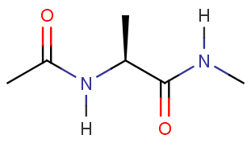
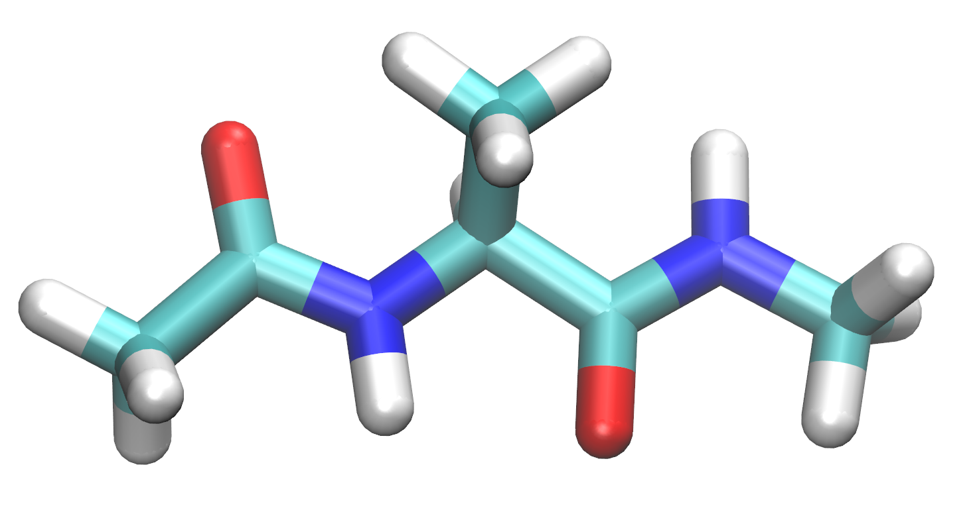
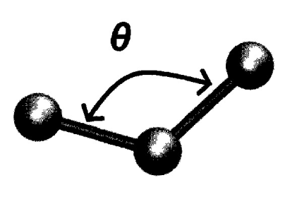
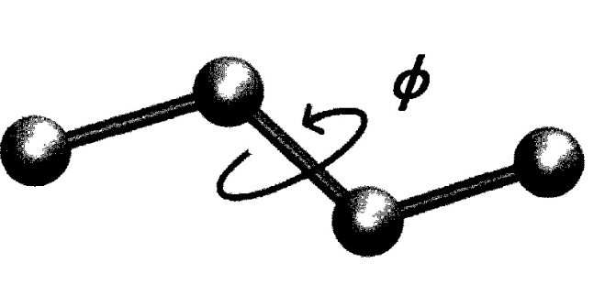
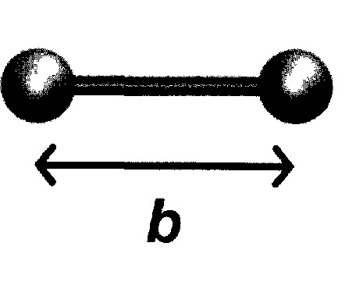
Alanine “dipeptide”
ACE
Ala
NME
Bonded energy terms
+ Electrostatics
+ Van der Waals
The forcefield is a database of interatomic parameters.

Slide 9
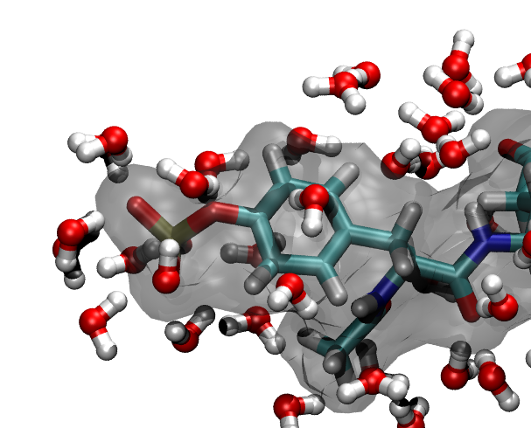
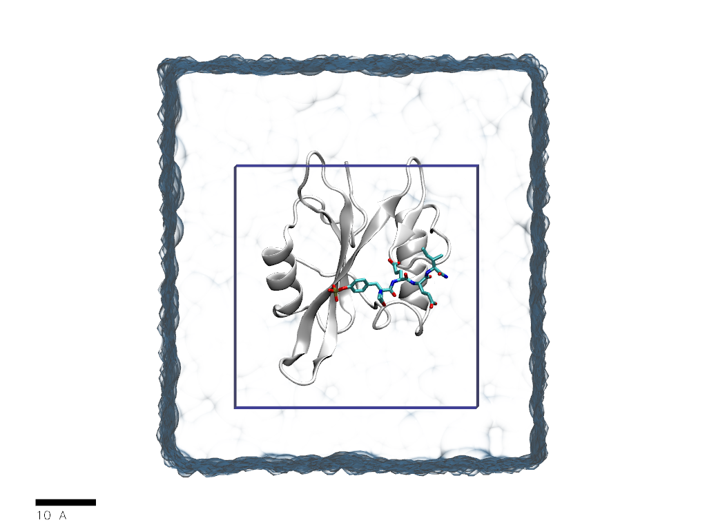
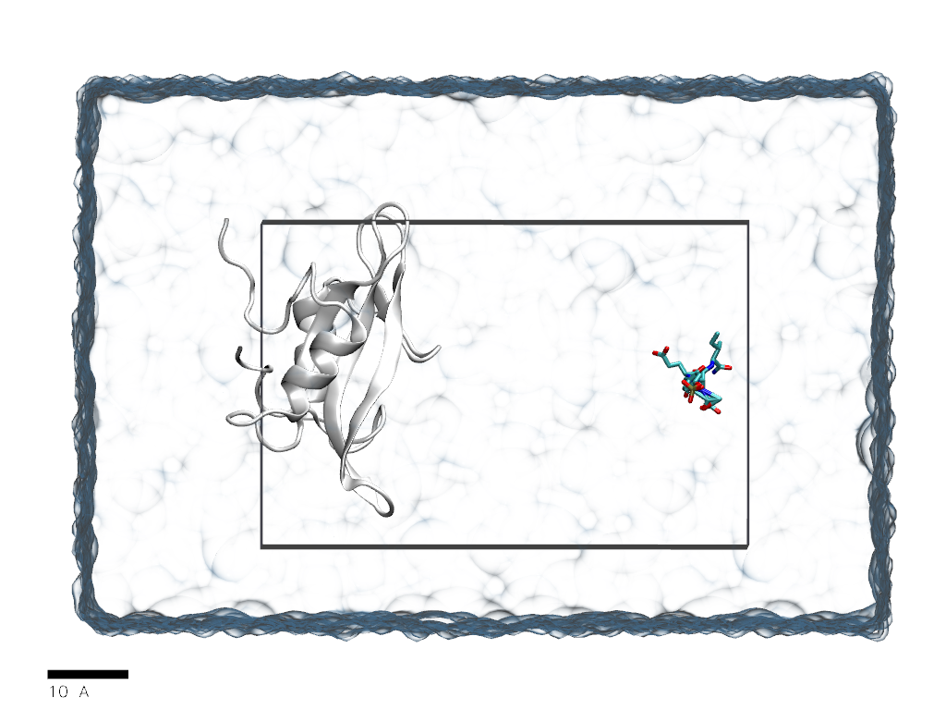
Explicit solvation
→ O(10⁵) atoms
Unbiased dynamics
Update every 10⁻¹⁵ s (1 fs)
7 nm
7 nm
SH2:pYEEI
10 nm

Slide 10
Patience and limits
Factors affecting simulation speed (typically measured in nanoseconds per simulation day, ns/day):
System Size:
Practical range: Approximately 100 amino acids, corresponds to roughly 30,000 atoms.
Computational Hardware:
Desktop/workstation-class machines recommended;
Laptop hardware insufficient;
GPU acceleration is crucial.
Software Optimization:
Choice of simulation software critically impacts performance.

Slide 11
Event ≡ Binding / Unbinding / Folding / Unfolding / …
* 1/t_{on} = association rate of SH2-pYEEI × [pYEEI]
Ability to “play” biomolecular processes at all-atom resolution in silico
Molecular bases of folding, binding, selectivity, gating…
Large gain
E.g.*: t_{on} ~ 30 µs → → 10¹⁰ integration timesteps → → 15 years single-CPU compute time
Large cost
Notes:
while I can not have 100s of supercomputers, I can have 100s of gpus. what do I need? enthusiastic volunteers
(or 1 cluster: 128-cores cluster, 50k €)

Slide 12
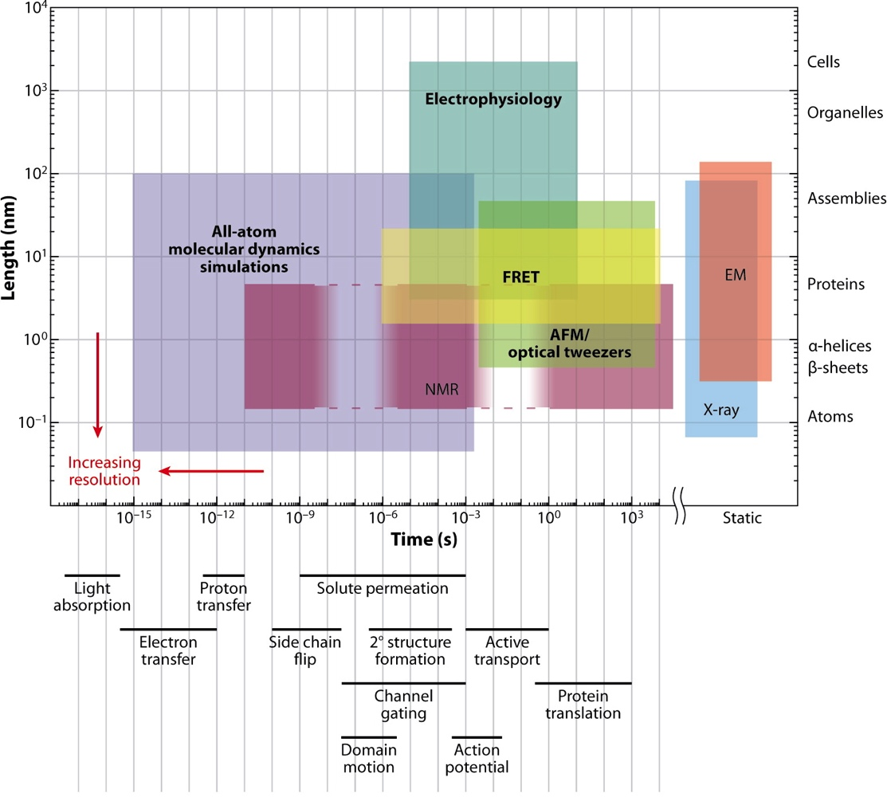
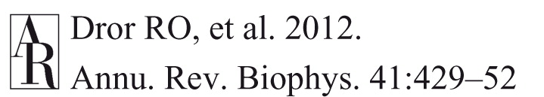
Timescales overview

Slide 13
OpenMM

Slide 14
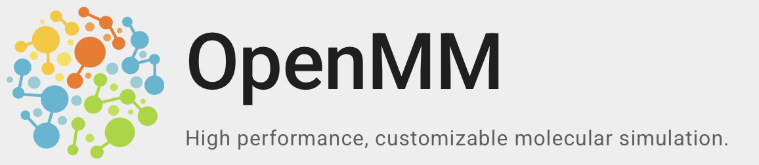
.org
OpenMM is a high-performance molecular dynamics simulation toolkit specifically designed for biomolecules.
Versatile simulation capabilities spanning:
Proteins;
Nucleic acids;
Small molecular systems.
Comprehensive computational features:
Supports multiple force fields;
Flexible integrator options;
Cross-platform compatibility (CPUs and GPUs).
Open-source software:
Core implementation in C++
Multiple language bindings, including Python.

Slide 15
Basic Workflow (object-oriented)
Download, complete and edit the structure:
Topology (i.e. the identity of atoms, bonds, etc.)
Positions (i.e. the starting coordinates)
Create the system object.
Create the integrator object.
Create and add custom forces to system if needed.
Define the simulation object.
Set the initial positions and velocities.
Minimize.
Run the simulation.
(Analyze the results)

Slide 16
Integrators
...are algorithms that solve the equations of motion for a system.
OpenMM includes several integrators, e.g. Langevin dynamics and Verlet integrator (and additional forces like barostats and thermostats*).
Different integrators are appropriate for different types of simulations and conditions (e.g.: NPT vs NVT).
[*] Thermostats: modify the velocities of particles to maintain target temperature.
Barostats: modify the system volume (box dimensions) to maintain target pressure.

Slide 17
Simulating a system
Once a system has been defined and the force field and integrator selected, it can be simulated.
The simulation (run) involves running a series of steps, where each step involves calculating the forces on each atom, integrating the equations of motion, and updating the system's coordinates.
After the simulation, data analysis can be performed to obtain information about the system's behavior and properties.

Slide 18
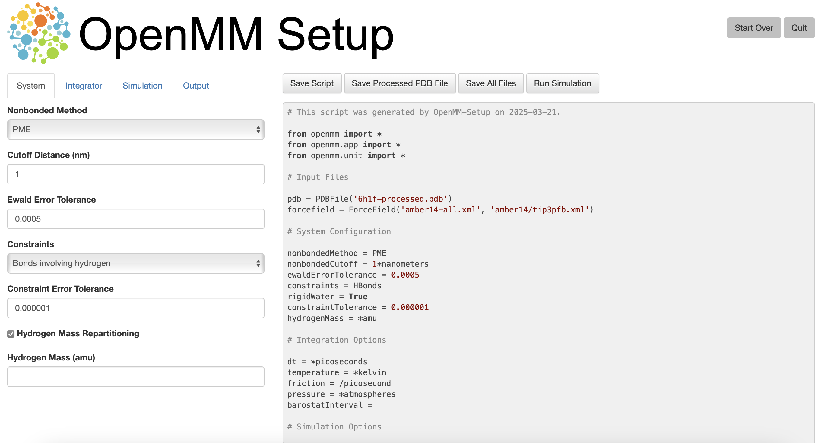
OpenMM-Setup Application

Slide 19
Let’s pick a test system

Slide 20

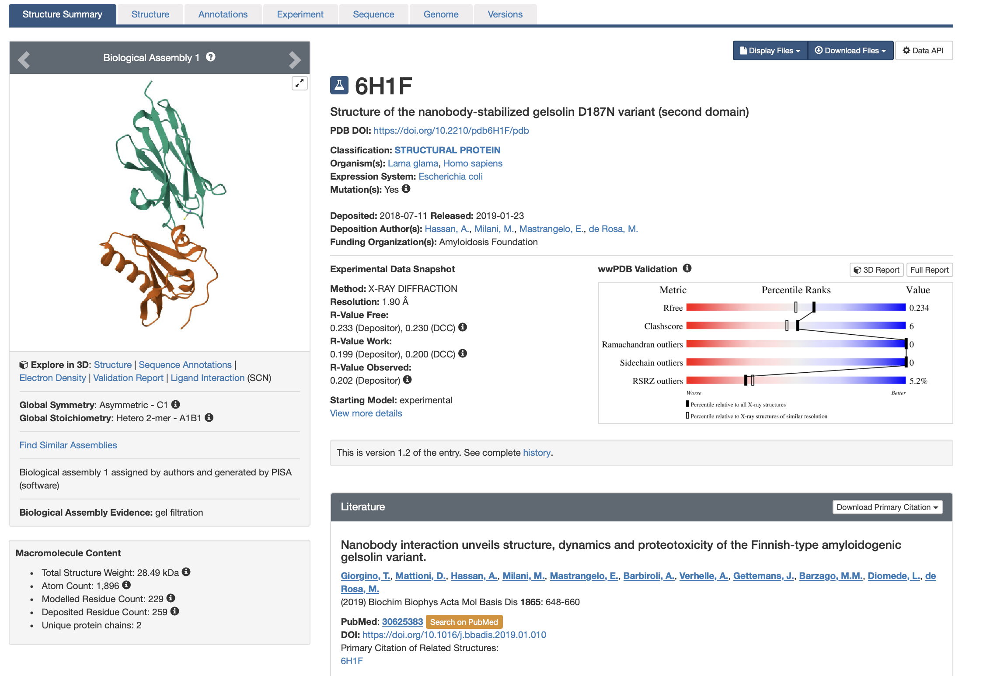
6H1F: Gelsolin G2+nanobody

Slide 21
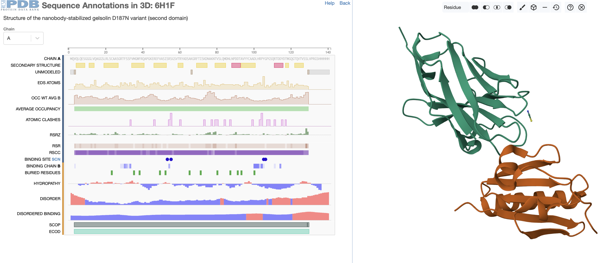
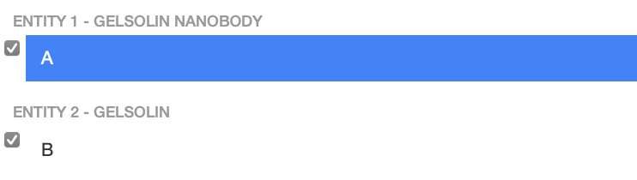
Which one is the nanobody?
SHEET
HELIX

Slide 22
Which one is the nanobody?
Chain A
SHEET
HELIX
Chain B

Slide 23
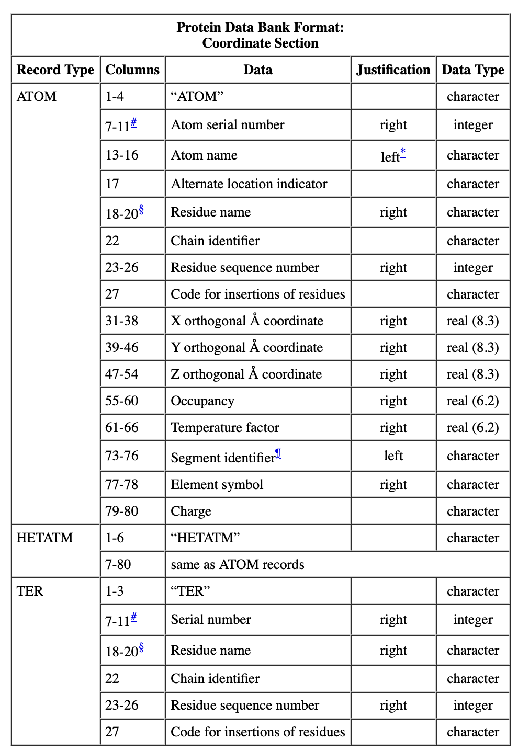
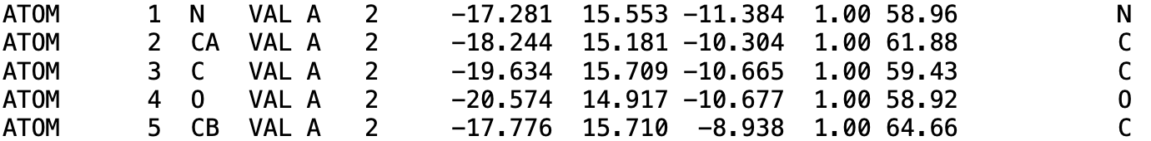
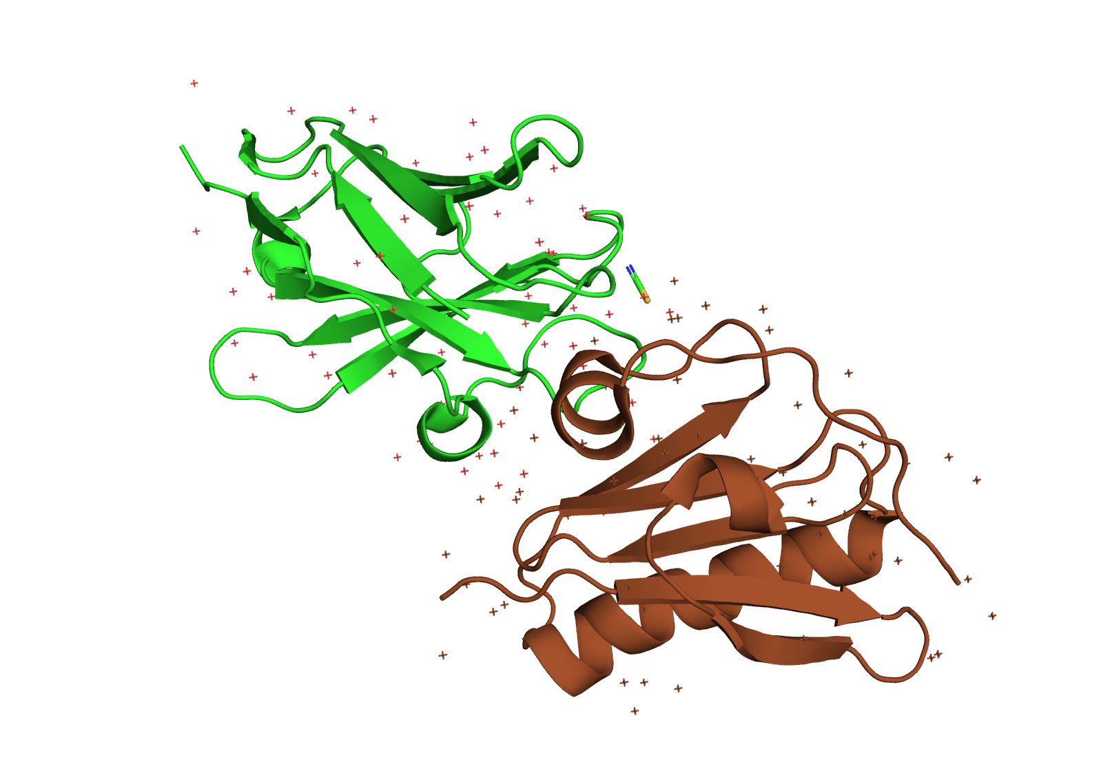
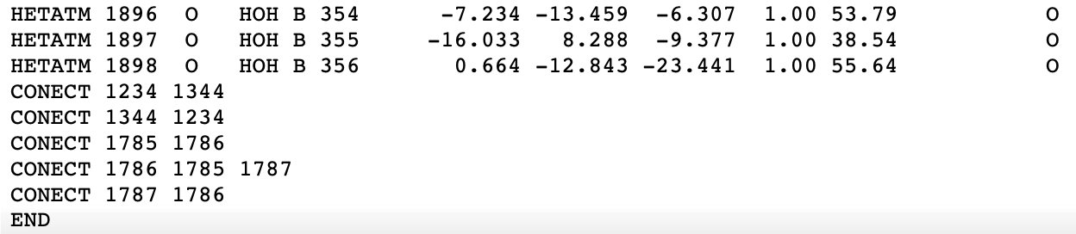
Looking into the PDB
First residue of 6H1F:
Last rows of 6H1F:
PDB format description
CONECT records should be specified for all
non-standard residues, to explicitly define bonds.

Slide 24
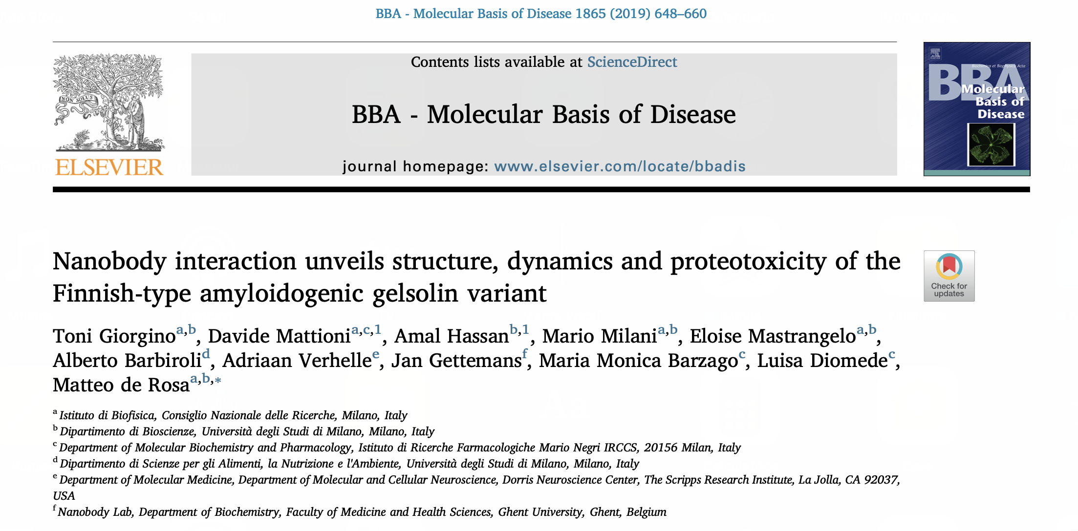
Giorgino T, Mattioni D, Hassan A, Milani M, Mastrangelo E, Barbiroli A, et al. Nanobody interaction unveils structure, dynamics and proteotoxicity of the Finnish-type amyloidogenic gelsolin variant. Biochimica et Biophysica Acta (BBA) - Molecular Basis of Disease. 2019 Mar 1;1865(3):648–60.
Journal link. Preprint.

Slide 25
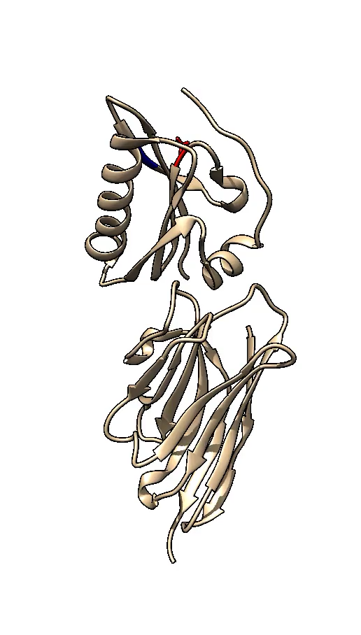
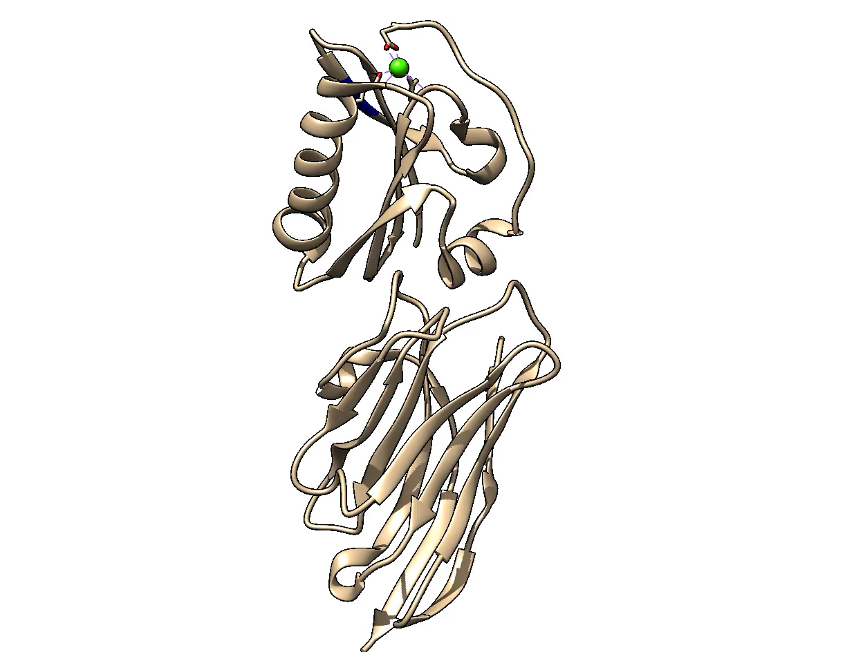
Three puzzles!
WT:Nb11 complex compared to D187N:Nb11
WT and D187N are virtually identical*: same structure, different function
Nb11 binds far from the furin cleavage site…
…and far from the Ca²⁺ ion
* Except Ca²⁺ binding
WT: 4S10, 2.6 Å
D187N: 6H1F, 1.9 Å

Slide 26
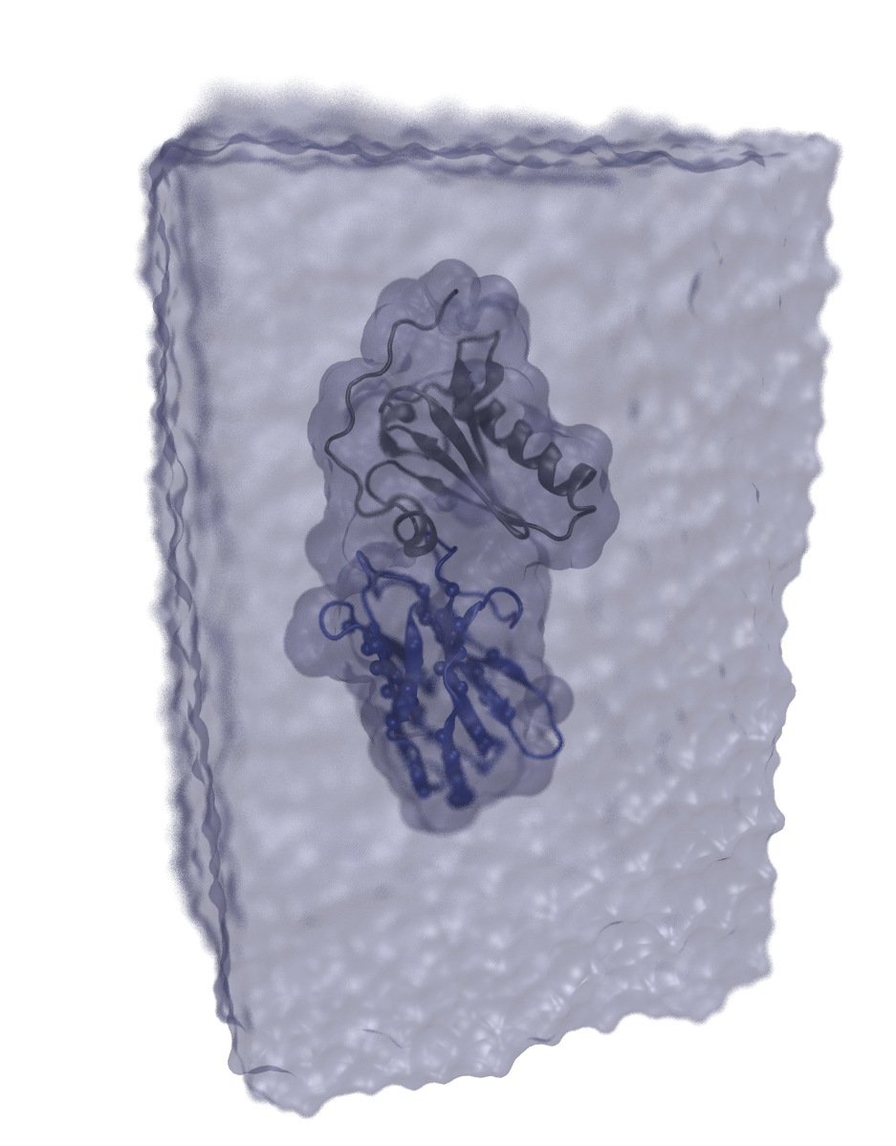
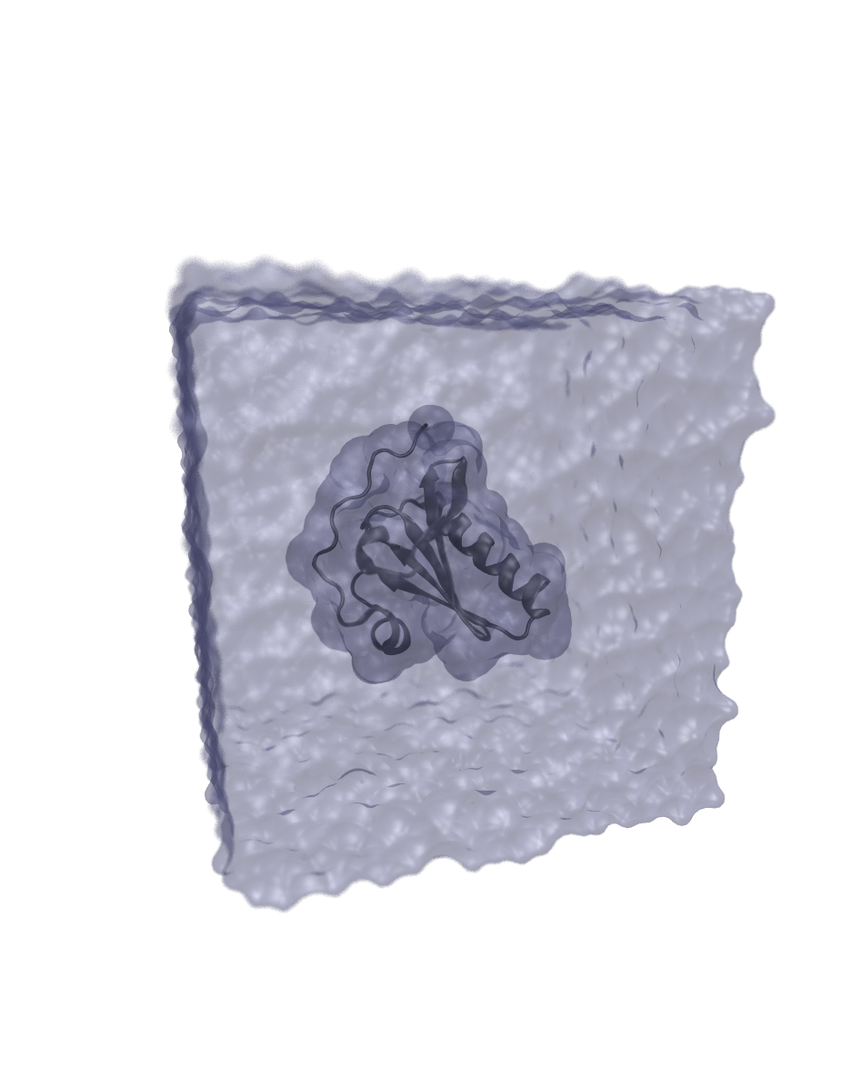
GSN ± Nb11 MD simulations
Unbiased sampling @300 °K CHARMM36
100 mM NaCl ~3 μs tot.
Harmonic restraints: ~25k/43k atoms SS Nb11 @ 0.03 kcal/mol/Å²
15Å
buffer
105 Å
(65 Å) ³
62 Å
67 Å

Slide 27

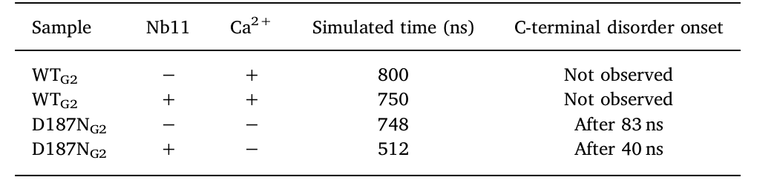
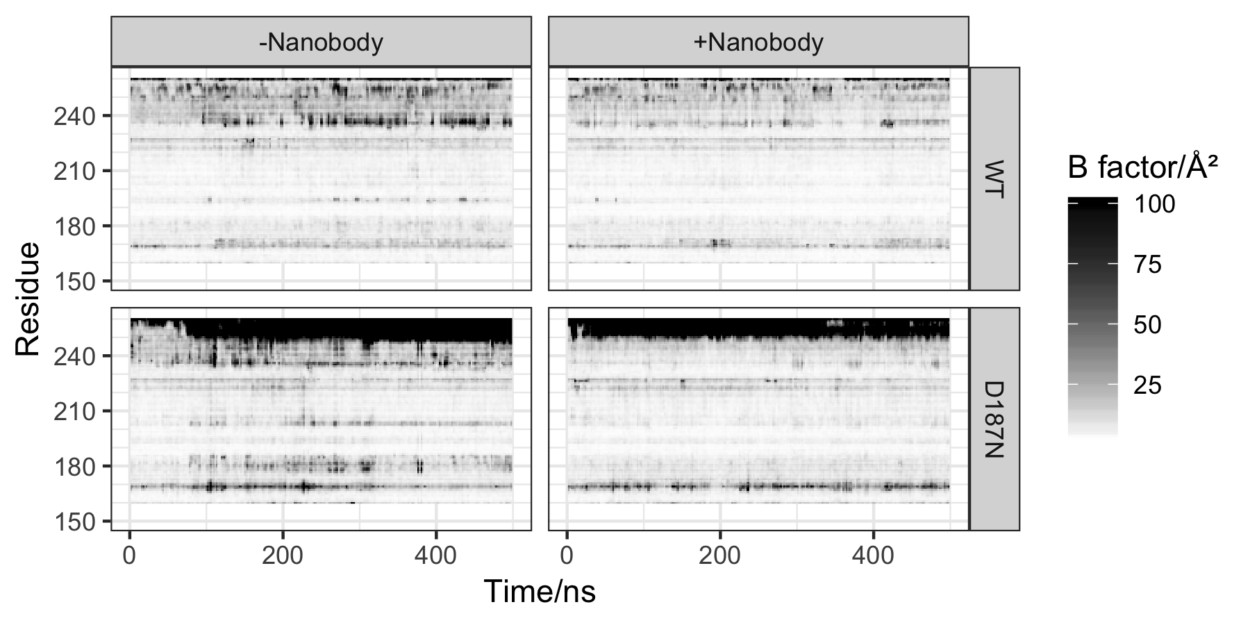
MD results
α₂
α₀

Slide 28
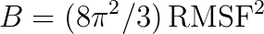
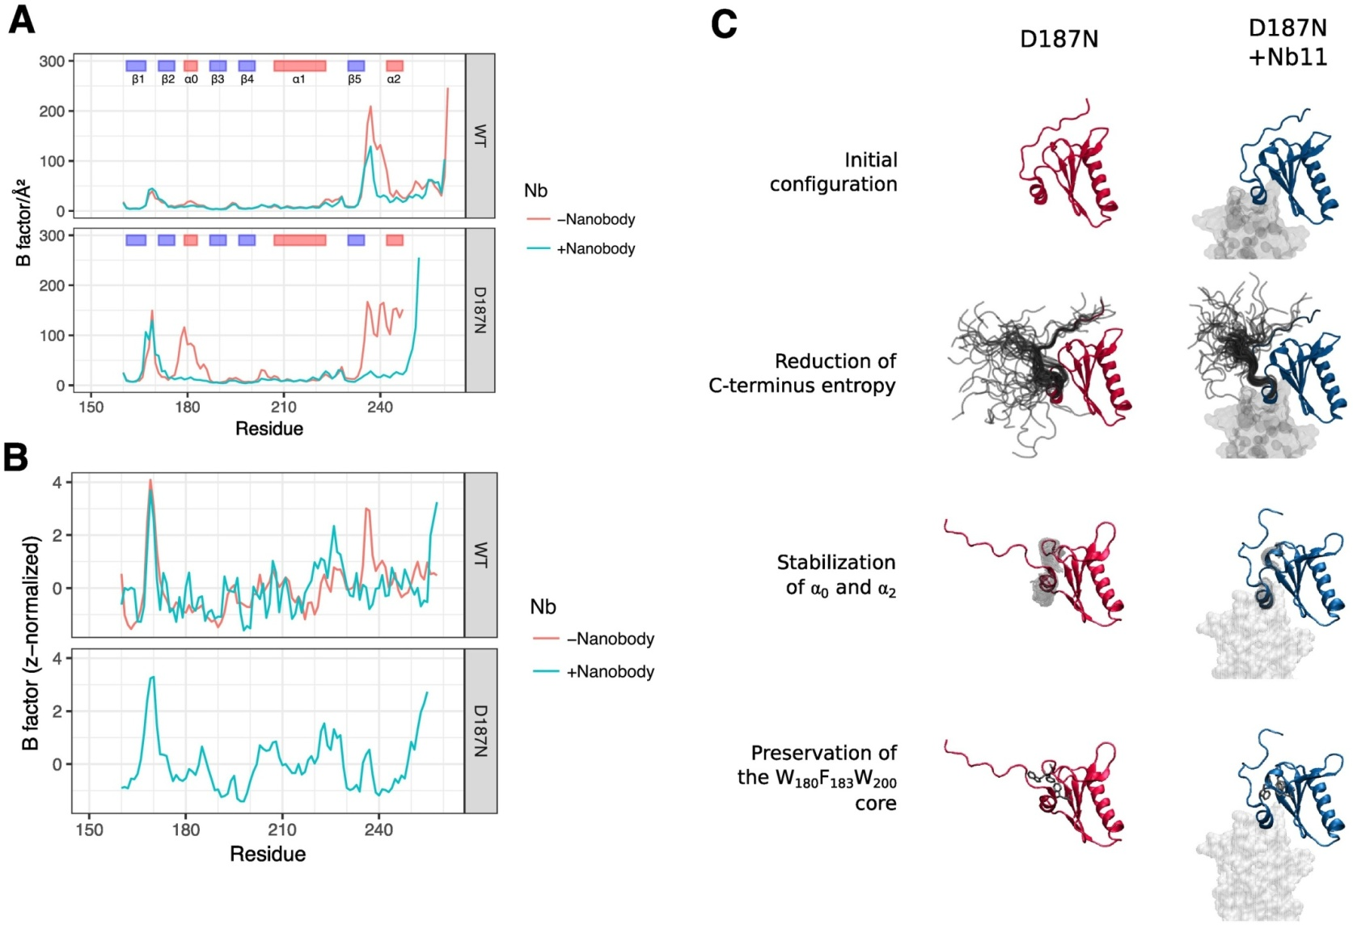

A matter of dynamics?
WT: Nb11 has ~ no effect on fluctuation profile (control)
Mutant: destabilized α₀, α₂
Nb11: complete stability recovery
MD vs exp. B-factors →
Notes:
b factor cristallografia comparabile a RMSF dopo aggiustamento

Slide 29
In practice

Slide 30
Using OpenMM on Google Colab
We’ll test OpenMM on Google Colab to run molecular dynamics simulations without the need for installing any software on your local machine.
Google Colab is a free Jupyter environment that allows you to run Python code in the cloud. GPUs runtimes are available.
To use OpenMM on Google Colab or locally, open the provided notebook (read the comments)

Slide 31
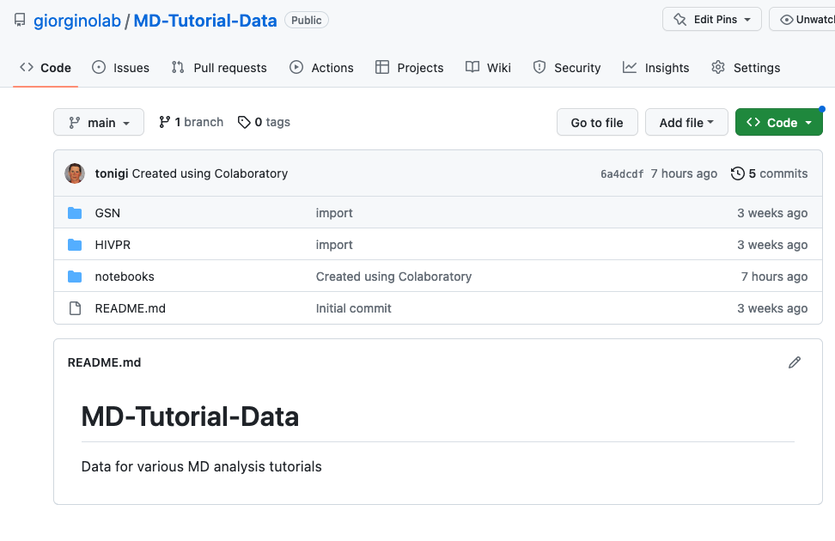
https://github.com/giorginolab/MD-Tutorial-Data

Slide 32
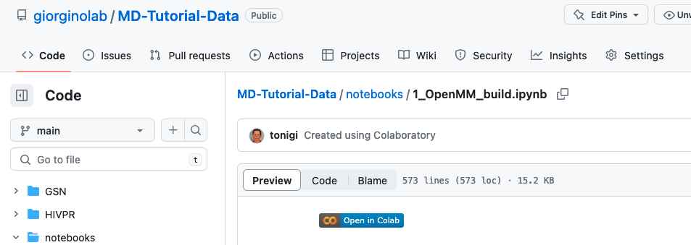
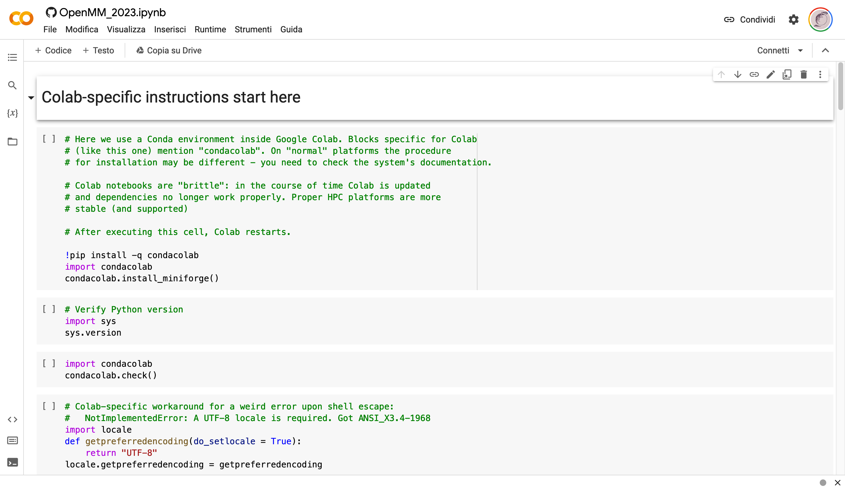

Slide 33
Once done..

Slide 34

Visualize
After you have done the simulation, load the minimized PDB and output.dcd in VMD or PyMOL.

Slide 35
Questions
How many atoms?
How many residues?
Disulfide bridges?
How many trajectory frames?
Simulation length in actual time?

Slide 36
More questions
Does density change? Should it?
What is the box size? Is it appropriate?
Relaxation time?
Plot the log file

Slide 37
Conclusion
OpenMM is a powerful tool for molecular dynamics simulations.
Good, if fragmented, documentation.
With its customizable force fields and integrators, it can be used to study a wide range of atomistic systems, e.g.:
“toy” polymers;
all-atom MD with major FFs;
ANN potentials.

Slide 38
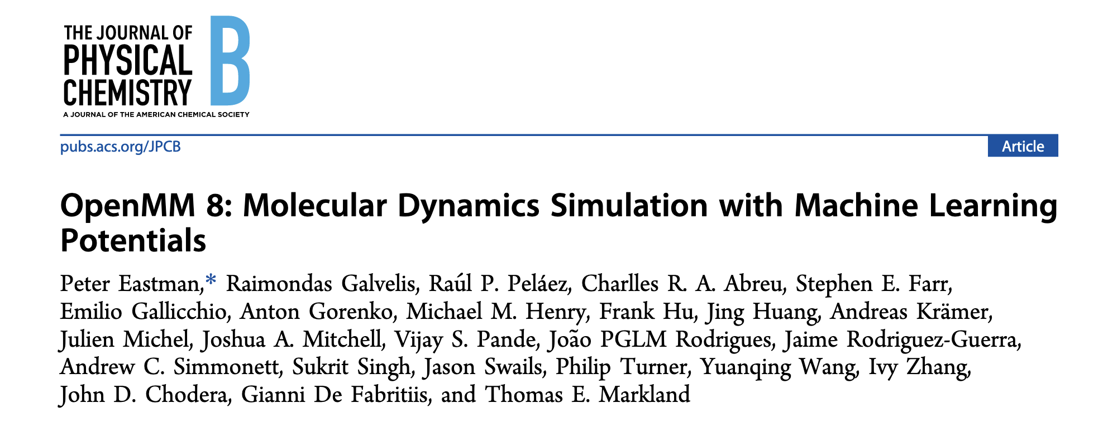
Resources for learning OpenMM
OpenMM.org website and documentation.
GitHub repository with examples and tutorials.
Community forums and mailing lists for support and discussion.
See also:
OpenMMtools
https://openforcefield.org/
HTMD, ACEMD
https://github.com/openmm/pdbfixer
Charmm-GUI

Slide 39
End

